Slide 1


AGRO TRACKER
Demo version
Longitudinal agricultural tracker with growers
www.bazisgroup.com

Slide 2
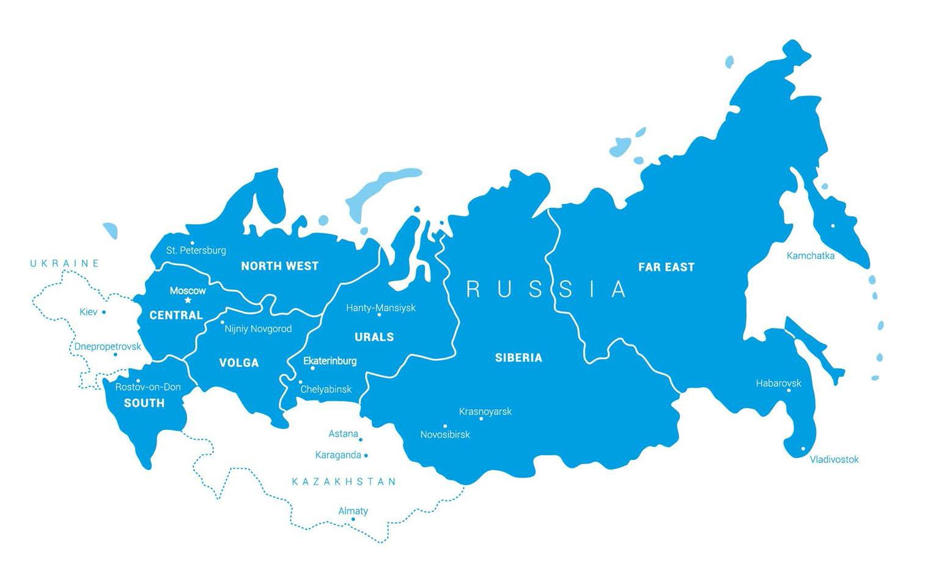
RESEARCH METHODOLOGY
1. SAMPLE SIZE (per wave)
126 growers
SAMPLE SOURCE
Bazis agro database of 1800 growers
QUOTAS
Region, farm size, crops
FREQUENCY
Twice a year
5. REGIONAL SPLIT
Center, Volga, Urals, Siberia, South, Far East, North West

Slide 3
YOU WILL HAVE ACCESS TO THE FOLLOWING INFORMATION
Fleet composition, number of machines, and wear rate by farm size and specialization
Repair and service segments. Segments with the highest potential for repair by dealer
Current market shares of brands by farm size and specialization
The most frequently used sources of information about agricultural equipment
Planned purchases for the next 12 months by equipment brand and type, by farm size and specialization
The biggest segment of farms with the highest potential for your company

Slide 4
KEY FINDINGS
As in the previous wave, 1/3 of farms are planning to purchase equipment over the next year
There is a steady demand for vegetable harvester, spreader, self-propelled seed drill and tractor of foreign brands
The larger S arable land, the higher the share of foreign equipment in the fleet
The number of foreign machines planned for purchase has doubled
The share of companies planning to buy tractors has not significantly changed. Tractor is still one of the most popular equipment types
> 80%
of service works are still performed in-house
81 000 rubles
is the average annual spend on parts for a single machine, which is 23% higher than last year's numbers
~50% of farms use precision agriculture tools and farm management information systems (1C Enterprise 8.0)
4

Slide 5
WHY JOIN BAZIS AGRO TRACKER
1
The ONLY tracker of Russian farmers’ equipment needs, attitudes and buying behaviour
2
Addresses key information needs including future brand buying intentions
3
Cost-effective approach combined with robust sample design
4
Ability to add your own customized questions
5
Bazis Group is an established expert in agricultural research

Slide 6


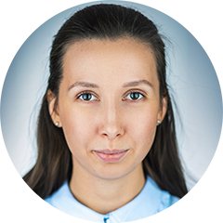
www.bazisgroup.com
YOUR BAZIS AGRO CONTACTS
ALEXANDRA PERINA
RUSSIA
Ekaterinburg
R. Luxemburg, 22-909 Ekaterinburg, 620075
perina_ai@bazisgroup.com
Alexandra Perina is an expert in managing projects in Russia and CIS. She carries out complex quantitative studies and has good skills in data entry
+7-343-288-57-13
USA
Chicago
4320 Winfield rd., #200
Warrenville IL 60555
+1-630-818-7144

